Slide 1

Heart failure
Clinical records

Slide 2
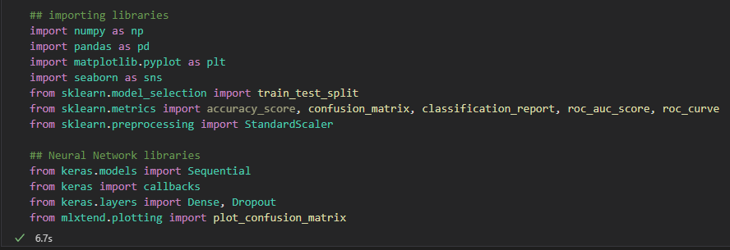
Libraries

Slide 3
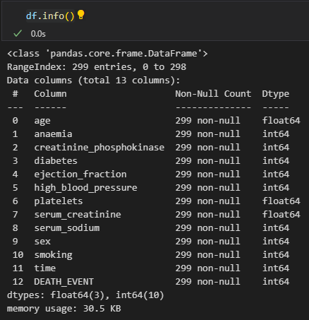
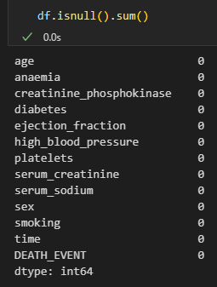
Data Preprocessing

Slide 4
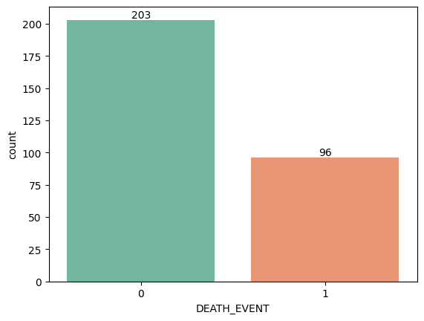
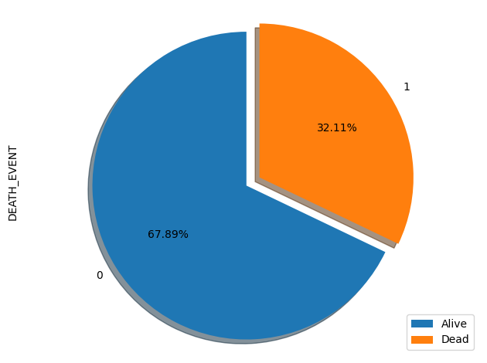
Exploratory Data Analysis
Imbalance Dataset

Slide 5
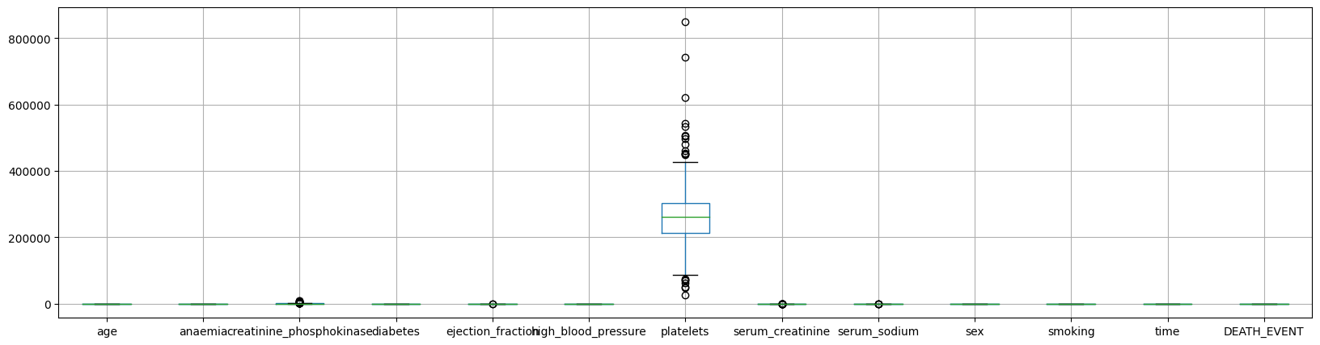
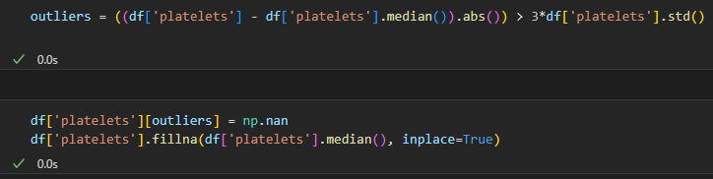
Exploratory Data Analysis
Outliers
Notes:
Outliers formula: if the absolute distance between the datapoint and the median is greater than 3 times the standard deviation, then it is considered an outlier.

Slide 6
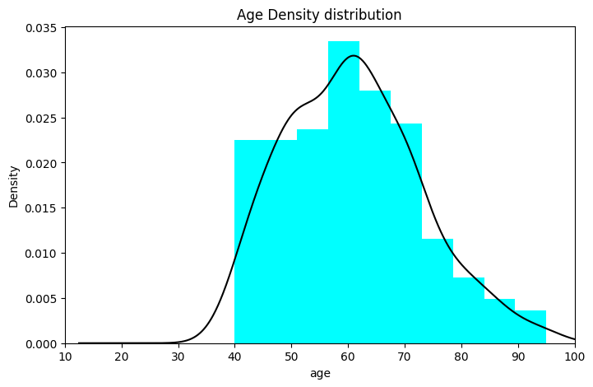
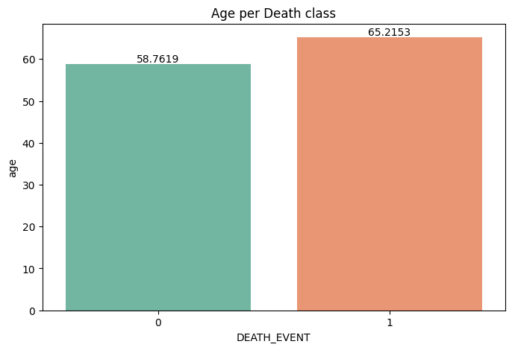
Exploratory Data Analysis

Slide 7
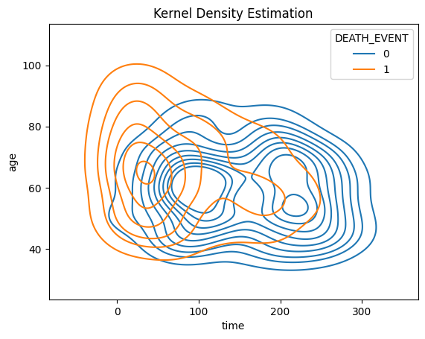
Exploratory Data Analysis
Notes:
The higher the age, the more probability to get a heart failure and therefore die, regardless the follow-up sessions the person has.
The more follow-up sessions and younger, the higher probability to not die due to a heart disease

Slide 8
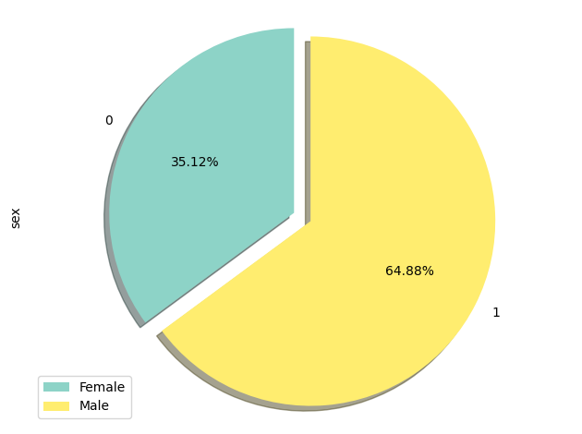
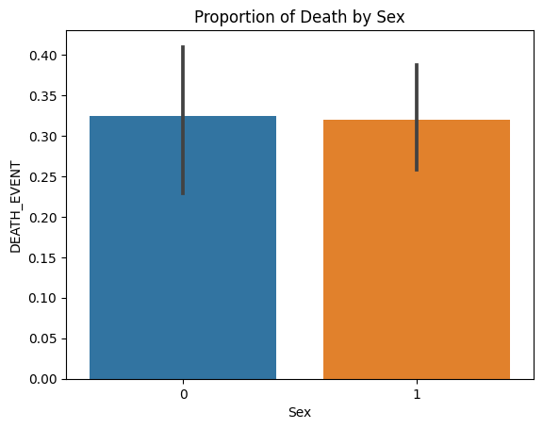
Exploratory Data Analysis

Slide 9

Machine Learning Model
Artificial Neural network

Slide 10
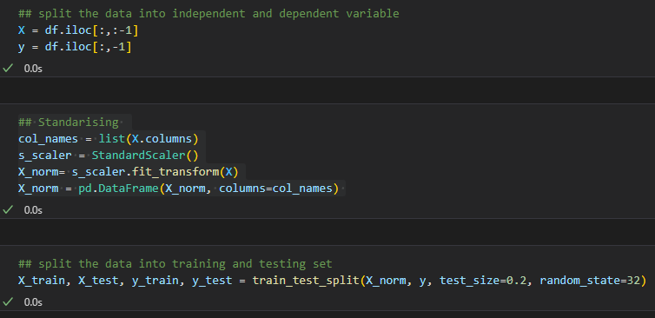
ANN

Slide 11
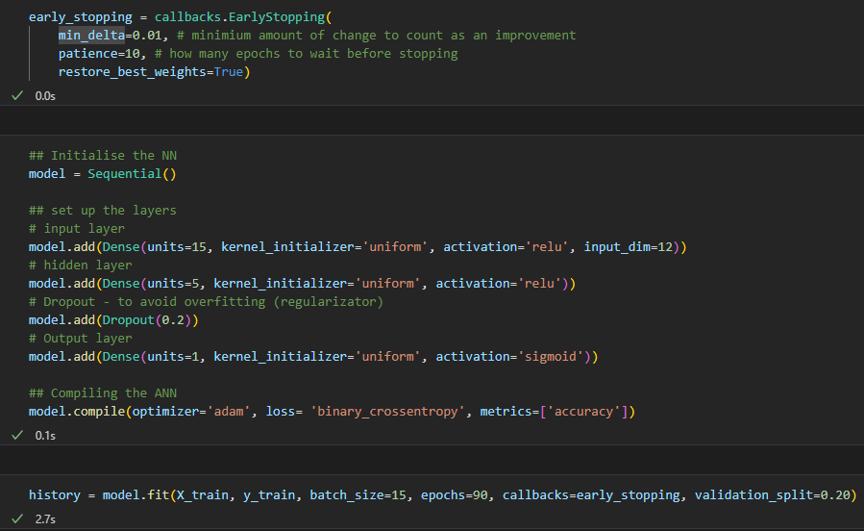
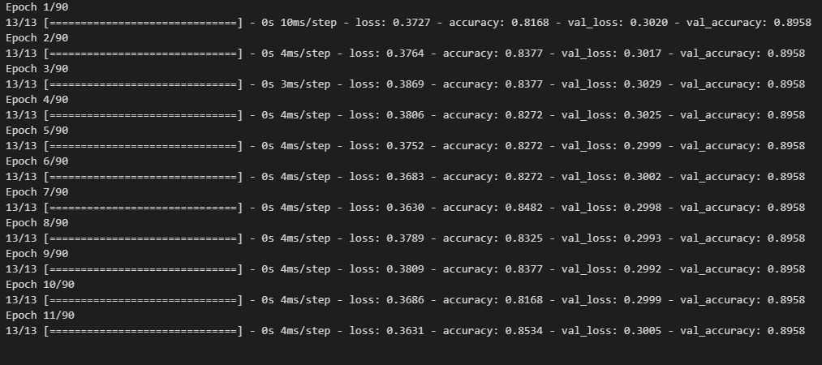
ANN

Slide 12
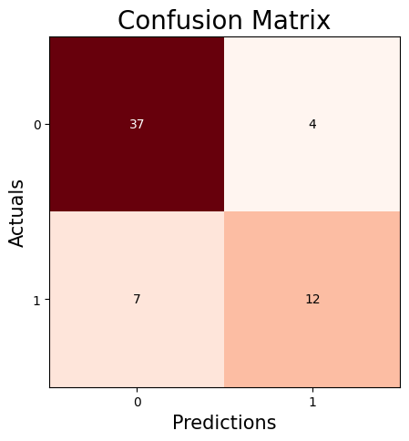
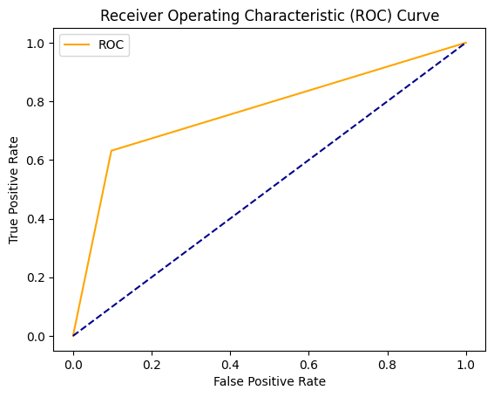
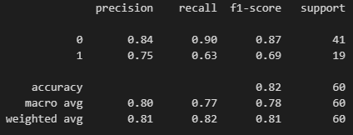
Evaluation Metrics
AUC: 0.767009

Slide 13
THANKS

